Slide 1

Welcome to the Virtual Premier College Intern Program WebEx!
Type your name and introduce yourself in the chat!

Slide 2
Virtual Premier College Intern Program
Ms. Kristina Whitfield & Ms. Brenna Cyr
AFPC/DP2ZP
28 May 20

Slide 3

Overview
Internship Overview
Symposium
Senior Leader Mentoring
Peer-to-Peer Mentoring
Group Project
Spirit Boxes
Please stay muted and type your questions in the chat! We will have Q&A at the end of the briefing.

Slide 4

6-Week Virtual Internship Overview 5-wk Virtual Experience & 1-wk Potential In-residence
15 Jun Entrance On Duty
Use own personal devices
No allowance or stipends given for personal devices usages (i.e. Wi-Fi usage)
Will complete Internship Feedback
Week 1
∙In-processing
∙Virtual Symposium
Week 5
*Potential In-residence
Site Visit
Week 6
Group Presentations
Week 2
Air Force 101
Week 3
∙Functional Experience
∙Group Work
∙Mentoring
Week 4
∙Functional Experience
∙Group Work
∙Mentoring

Slide 5


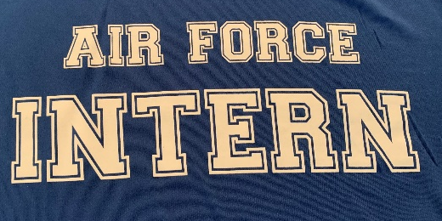
Symposium
We will host a 3-day virtual symposium during your first week!
A virtual networking mixer will also be held each day after the symposium.
16 Jun
17 Jun
18 Jun
My Fit Day
My AF Day
My Career Day
School Spirit Day!
Show your school spirit by wearing your school shirt!
Wear your
Air Force Intern shirt!
Dress for Success

Slide 6
Senior Leader Mentoring
You will get to experience mentoring from an Air Force Senior Leader
Your Senior Leader Group will meet on 4 occasions during the 6-weeks
Embrace your unique opportunity!
Think about what you want to ask our leaders!
Final Words of Wisdom
Meet
& Greet
Why the
Air Force?
Followership

Slide 7

Peer Mentoring – Friday Frappuccinos
During your internship, PALACE Acquire (PAQ) and COPPER Cap (COP) interns will act as Peer Mentors
There will be 3 sessions throughout your internship
Your mentor will be PAQ/COP from your career field
Prepare any questions you may have for them about their intern experience with the Air Force!
PCIP
PAQ/COP
Permanent
GS- 3/4/5/7
GS- 7/9/11/12
GS- 11/12/13

Slide 8

Group Project
Over the internship, you’ll get to work on a group project researching an Air Force Major Command and displaying innovation during presentations on the last week
Presentations will be live to a virtual panel

Slide 9

Spirit Package
Recently, we sent an email requesting your current address and shirt size
Ensure your response is accurate as we are sending Spirit packages!
This will include your Air Force Intern shirt you will wear on Day 2 of the symposium

Slide 10



FAQs
How often do we get paid?
Bi-weekly (Fridays)
What will my schedule look like?
You will work 40-hours a week
Do we still get benefits although we are in a virtual realm?
Yes! This will be discussed further at the symposium.
Will we receive a Common Access Card (CAC)?
You will most likely not receive a CAC card during your internship
MaxiFlex
Your daily schedule will be discussed with your supervisor on your first day
The final determination will remain with your local organization during your site-visit.
CFT may have set times

Slide 11


Questions
Download the Air Force Civilian Service
App from the App Store to connect with
other PCIs and your Career Field Team!
Join the group!
Group Code: 184all

